Slide 1
The importance of time frame in tackling new and emerging crime problems: The Eco, Devo, Evo Framework Australian Institute of Criminology November 2019 Paul Ekblom Department of Security & Crime Science UCL
This work was supported by the research project, ACCEPT: Addressing Cybersecurity and Cybercrime via a co-Evolutionary aPproach to reducing human-relaTed risks" (http://accept.cyber.kent.ac.uk/), funded by the EPSRC (Engineering and Physical Sciences Research Council) in the UK, under grant number EP/P011896/1 and EP/P011896/2.

Slide 2
Background
Been working on evolutionary approaches to crime/security technology and techniques since mid-90s – latest a study of Provisional IRA weapons (with Paul Gill)
A current project has taken me deeper and more systematically into the evolution of crime in the cyber domain
Project ACCEPT aims to apply a co-evolutionary approach to cybercrime, and in particular to consider the whole system of humans plus technology
I’ll be offering insights from this work – but not heavy cyber jargon!
The ideas are still evolving with the collaboration of colleagues, and still a bit abstract
Hope to get some feedback

Slide 3
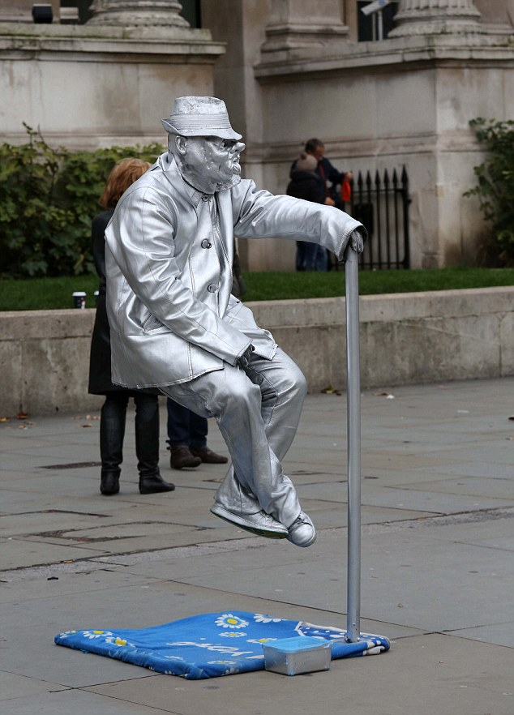
Crime & Security – too Static a View?
Evidence-based approaches seeking ‘What works’, assume that what works now, will continue to do so indefinitely
Situational Crime Prevention research suggests crime displacement is of only limited significance – solutions are ‘once-and-for-all’
But most studies have focused on trends/outcomes in the short-term, in domains, e.g. burglary, where there has been little technological change over relevant timescale, & where offending often opportunist
Few Situational approaches view offending over a person or OCG’s career
Security approaches often acknowledge ‘crime as moving target’ but don’t systematically address this
I aim to move security thinking into a more dynamic place, emphasising change
I draw on Biology, Systems approaches and Cultural Anthropology to articulate the understanding of problems, focus research questions and sharpen solutions

Slide 4
Significant Examples of Dynamic Crime/Security Problems
Card theft
Chip-and-pin card security a significant success at first, but diminished in light of contactless transactions; then we saw 3D printing of fake card-scanning slots on ATMs; online sales entirely bypass card-based security
Car theft
Sustained drop due to improved security (immobilisers etc) now waning as we see burgling for keys, misuse of wifi extenders transmitting key signal from house to car
Terrorism and organised crime
Persistent, highly-motivated, unfazed by tactical defeat, involve acquisition of resources, outsourcing, R&D
Cybercrime
Rapid development and dissemination of opportunities, techniques, countermeasures
Hyperconnectivity means annihilation of practical constraints of distance, and very different ratio of effort/scale in relation to reward
Internet of Things – exponential growth – heading for 50bn connected items
Crime As A Service on Dark Web

Slide 5
We Therefore Need Solutions that are:
Dynamic and adaptive rather than static
Out-innovating adaptive offenders against a background of technological and social change which favours first the one, then the other side
Anticipatory rather than reactive
The future won’t be ‘more of the same’ – changes may be nonlinear
Varied – to fit diverse contexts & challenge offenders with new problems
Intelligently scalable
Slavish replication of success stories often followed by implementation failure in different contexts
Able to handle complexity & complex adaptive systems – agents with diverse motivation & resources adapting to and anticipating each others’ moves
Simple crime triangles, cardboard cut-out rational offenders and a hotch-potch of poorly-integrated perspectives aren’t good enough
Sensitive to different time frames over which crime and security are enacted, and over which they change

Slide 6
Candidate Time Frames
Here-and-now – normal focus of Situational Crime Prevention and Law Enforcement
Career
Of individual agents, whether individual offenders, organised crime groups or professional preventers, as they acquire repertoires of actions, techniques and technologies
Change across generations and populations
Of people and groups
But also of procedures, services, material products & places, and info technologies
We must address all these time frames, the better to deal with present problems and to anticipate future ones, and handle their dynamic nature

Slide 7
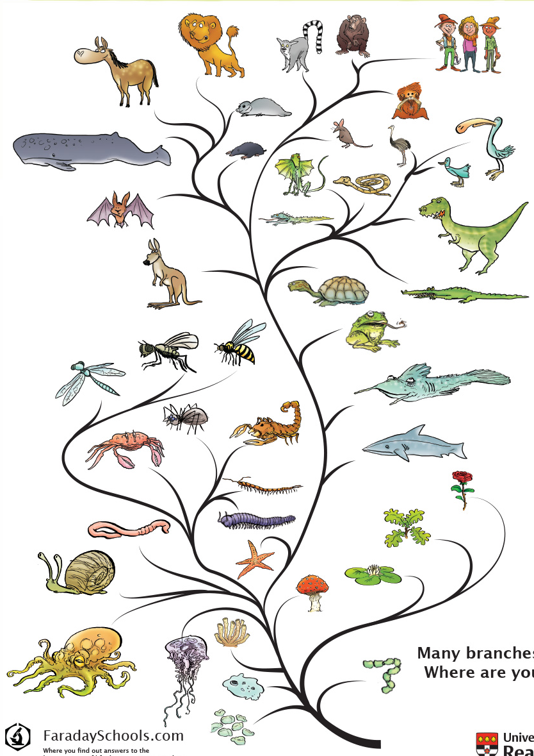
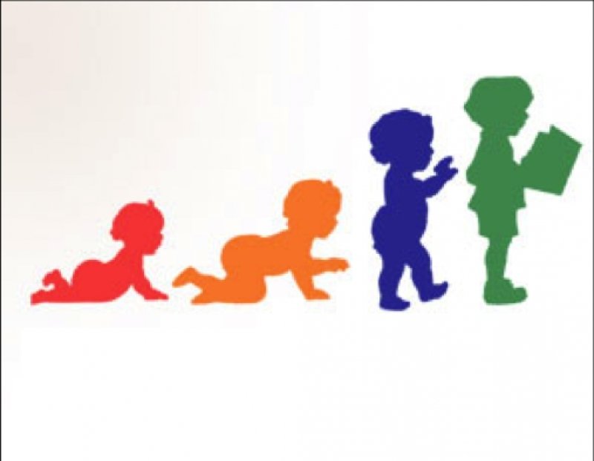
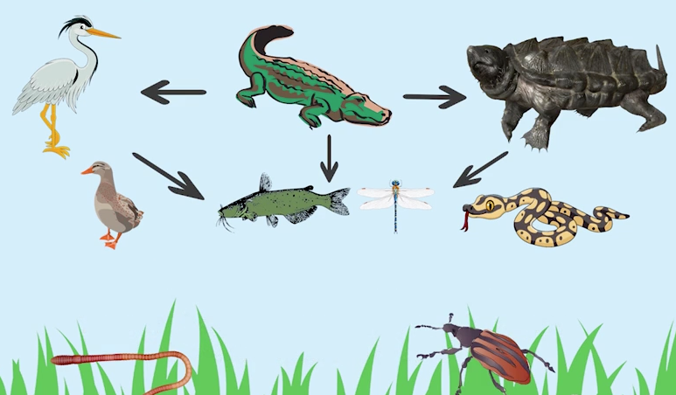
Eco, Devo, Evo
To make the most of these time frames we can borrow from the Life Sciences to respectively distinguish
Eco – ecology and ecosystems
Devo – development and learning
Evo – evolutionary and co-evolutionary

Slide 8
Eco, Devo, Evo
These frames can be translated into
Human performance, learning and cultural evolution
Also the technological equivalents covering operational products, places and systems; those under development; and the succession of versions and innovations unleashed on the market
Not implying a universal time scale here – for example, Evo in cybercrime may be faster than Devo in offender careers

Slide 9
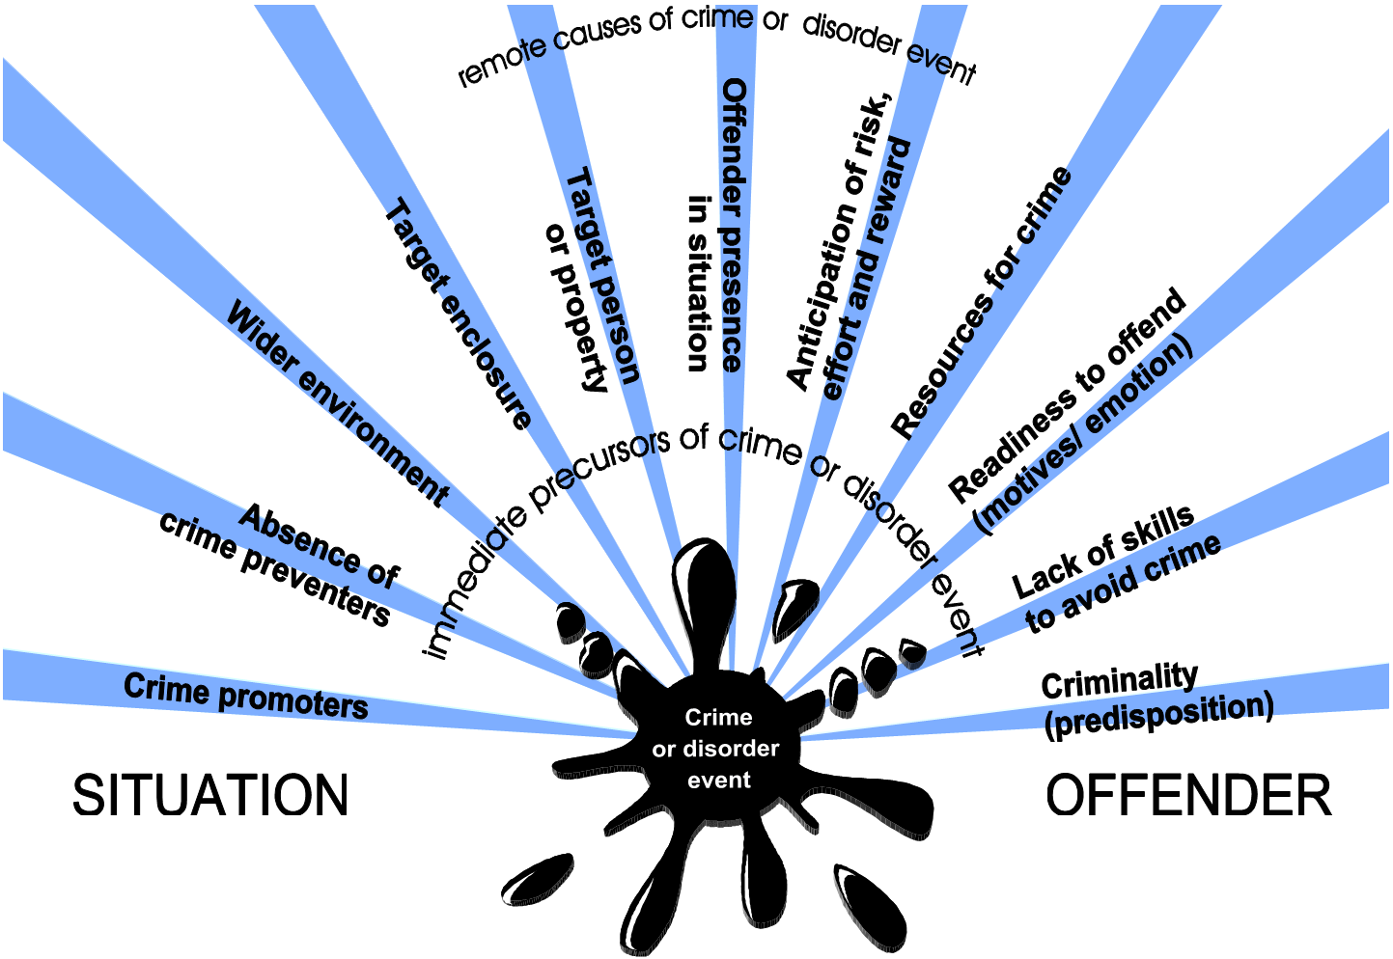
Time Frames – ECO
Eco covers the here-and-now ecological interactions of agents
Within their environment, attacking or defending a target of crime, and conflicting or collaborating with each other (offenders and preventers)
Agents seen as performing with their existing repertoire of behaviour and resources
To acquire tactical info on immediate contingencies (eg hostile reconnaissance),
To respond to tactical opportunities, forage for them or actively create them
Agents also respond to precipitators (prompts, provocations, permissions, pressures) and set them up for others to experience
Preferred framework covering offenders, other agents and material or human targets in the immediate environment – Conjunction of Criminal Opportunity
CCO integrates all the crime science perspectives in a one-stop shop, though it’s not the last word – needs to connect with wider ecological/social perspectives, more distal causes

Slide 10
Time Frames – ECO – Nature of Agents
Important to get the concept of agents right
People/ groups/ organisations can be viewed as ‘Caused agents’ who are both caused and causing:
Caused: prior predisposition, perceptual tendencies, motivation, precipitation
Causing: engendering events through their actions on basis of goals, plans, decisions, affordances – perceived utility of people/ things in their environment
Focus here is mainly on the active, causing agent perspective
Agents nowadays include autonomous ICT with AI/Machine Learning

Slide 11
Time Frames – ECO – Agents and Roles
Agents take on roles
Crime: Offenders, Preventers, Promoters, Victims, Responders
Civil: User, Resident, Employee, Passer-by…
They overlap between and within these 2 categories (victim can be preventer, employee can be promoter, offender)
The crime (and also the civil) roles interact with one another, and with the immediate environment
Incidentally, via routine activities and geometry (crime generators)
More deliberately (seeking crime attractor places/ avoiding detractors)
From a systems perspective there is some symmetry between the good guys and the bad
A crime preventer’s problem is an offender’s opportunity, and vice-versa

Slide 12
Time Frames – DEVO
Devo covers changes undergone by agents or things within a lifetime, a (criminal) career or a generation –
I.e. those that endure beyond the individual criminal event/ situation
Devo changes occur through various mechanisms, eg:
Operational feedback from success or failure of agent’s own actions (this action reliably bypasses the car alarm)
Individual imitation and other forms of social learning
Cultural acquisition of values, attitudes, goals and techniques
Organisational development & growth of membership, operations

Slide 13
Time Frames – DEVO – Technology
We must also consider developmental changes undergone by technology – broadly taken to include product, place, system, procedure or intervention – during the working lifetime of individual items
Customisation during/after manufacture (e.g. boosting security properties in anticipation of exposure to increased risk)
Programming/self-programming (as with smartphones that learn your preferences)
Modification (eg hacking in the constructive, repurposing sense; adding security features in light of increased risk)
Updates and upgrades (not just ICT – ‘How buildings learn’ book)
All this is about making products/procedures/systems adjustable during development and operation so they can be customised to context, and to adapt to changes in that context – biological term is developmental plasticity

Slide 14
Time Frames – EVO
Initially inspired by ideas from biological evolution
Original Darwinian processes of variation, selection, transmission/ replication/ inheritance
‘Modern Synthesis’ of Darwin + genetics, viewing evolution as changing frequencies of gene variants (alleles) or traits in a population of organisms
More recent – ‘Extended Evolutionary Synthesis’ – later
But biological evolution is a highly-structured process (genes, chromosomes, mitosis/meiosis/sexual reproduction)
More recently, big developments in concept of cultural evolution in biology and anthropology – covering social and technological change – so I primarily draw on this
Cultural evolution shares similar algorithm to biological, albeit one that is looser and more debatable (controversy over memes as ‘cultural replicators’ equivalent to genes)
Cultural evolution exists in other animals but far stronger in humans because of high-fidelity copying (language, writing, mass-production, ICT; copy-process-not-product)

Slide 15
Evo – Global Perspective – Populations
Need to take closer look at some of the key concepts
Changes, variations in traits e.g. height or hair colour, occur in a population over successive generations
Population refers to the units that are evolving
Units can comprise
Individual agents in particular roles (e.g. offenders, preventers), OCGs, police/security organisations
Actions/things – perpetrator techniques/crime scripts, goals and plans, ICT operating systems or applications, sensors, tools and weapons
Here there might be literal lessons from evolutionary biology e.g. on emergence of body armour
Groups – these introduce special and controversial issues of multi-level evolution and reproduction (genes > cells > organisms > groups/organisations)

Slide 16
Evo – Global Perspective – Generations & Levels
Generation is usually clear in biological evolution, but a difficult concept in cultural/technological evolution
One iteration of a design or one version of software doesn’t reproduce itself as the next generation, but is artificially created, taking in info from predecessor and elsewhere,
This often happens in an evolutionary microcosm, protected in the designer’s workshop from market forces, until launch
Straight copying of images, software, 3D printing of products including tools/weapons probably doesn’t count (probably akin to cloning, e.g. taking cuttings from favourite apple tree)
Generation is difficult too with group-level
Do OCGs ever bud off subgroups, or even undergo the equivalent of sexual reproduction (mergers then splits)?

Slide 17
EVO – Cultural Evolution – Basics
From a cultural perspective, trait variants (e.g. alternative MOs or security interventions) are
Generated through innovation or simple serendipitous copying error
Selected e.g. on basis of success/failure
Replicated through various forms of transmission
And the successful variants become more prevalent in the population

Slide 18
EVO – Cultural Evolution Basics – Selection
Over generations, selection of fittest variants & inheritance of their properties leads to
Adaptation of the population of cultural traits to their environment, enabling survival, flourishment and replication in the material, social and informational world and
Perhaps forming a particular niche

Slide 19
EVO – Cultural Evolution Basics – Selection
Selection works by people choosing to
Copy a successful action or
Copy the actions of successful people/organisations
In security, note the importance of evaluation, and the cultural trait of evidence-based policy/practice
These apply and maintain a discerning selection pressure on security interventions
Through outcome criteria, they sharply define the ‘fitness function’, to judge the interventions by
Note that external factors continually change the environment (eg fluctuating commodity price of copper) so adaptation of criminals (or security) is never maximised/ finished

Slide 20
The Niche
Niche is an evo concept – a combination of properties of the agent and of the environment – a kind of ‘professional job description’
E.g. wolf spiders with long legs, adapted to hunting among leaves on forest floor
Criminals with financial/social skills, adapted to fraud, capable of exploiting fraud opportunities and coping with the risks
Arresting individual offenders/disbanding OCGs may not work if the niche for offending is allowed to persist – offender replacement
Niche has counterparts at other timeframes
Eco – opportunity to pursue what goal, with what resources, in what environment
and Devo – what career slot can an offender pursue or construct, acquiring and deploying what resources in an environment with what opportunity structure

Slide 21
EVO – Cultural Evolution Basics – Transmission/Replication
Cultural transmission is more complicated than its biological counterpart:
Vertical (parent-child)
Horizontal (peer-to-peer)
Oblique (e.g. from some experienced person other than parent)
Broadcast rather than 1:1 or 1:few e.g. over Internet
Transmission mechanisms include
Imitation
Recommendation sites (both can generate fashions or contagion in crime, security)
Teaching (Evo) which connects with learning (Devo) by individual recipients of the culture
Dissemination of tools and exploit kits e.g. with generation of computer viruses on Dark Web
Collaboration/co-offending to pool labour, specialist knowhow
Provision of crime as a service e.g. ransomware helpdesk etc

Slide 22
EVO – Cultural Evolution Basics – Transmission
In genetic inheritance, genes are recombined as clearcut ‘independent’ factors (Mendel’s pea experiments) which largely remain unchanged over generations
In cultural transmission there is often blending and (re)construction of multiple ideas in the information received by each generation – so in many cases, original idea is replaced by new forms which then become transmissible/ blendable in turn
In Crime Science, Scientific Realist accounts of evaluations look at replicable principles/mechanisms and practices which support the process of constructive development and generation of variety rather than slavish copying and roll-out at scale of what worked once, in one time and place

Slide 23
Evo – Acceleration and Boosting Efficiency
Some things accelerate evolution and boost its efficiency
Numbers of evolvers trying out mutations over long periods
Trillions of bacteria trying out new ways to infect hosts
Thousands? of disenchanted sales staff watching for vulnerabilities in cash registers
Ability to share innovations
Pathogens sharing genes that boost infectiousness or virulence,
Humans sharing ideas on Internet
Intensity and focus of selection pressures, especially predation
Boosts splitting of an existing species into multiple ones
Might predation by police engender different criminal specialisms?

Slide 24
Evo – Evolution of Evolvability
Evolutionary systems discover (then transmit) ways of speeding up the generation of potentially successful adaptations – like business process re-engineering to boost innovative capacity
In biological evolution, mix-n-match of sexual reproduction arguably evolved to keep innovating resistance mechanisms faster than parasites could learn to overcome them
And the development of modular body-plan genes has enabled advanced life forms to generate a huge variety of new physical shapes that are functionally plausible, with few complete duds

Slide 25
Evo – Cultural Evolution of Evolvability
In cultural/technological evolution we can boost evo of evolvability
Encouragement of variety, design freedom and performance criteria in the specification and design of security measures such as locks can avoid the ‘crack one, crack all’ issue
A combination of organised, tested theoretical principles and modular, recombinable practice elements can help practitioners generate plausible innovations that have a good chance of working first time
An explicit process of design, development, testing, monitoring and adjustment of products, places, interventions can select and refine these innovations
Making products/procedures/systems adjustable during development and operation so they can be customised to context – Developmental plasticity
Sharing and cross-fertilisation of knowledge and ideas
Ideally want to boost evo for security but retard it for offenders
Eg ‘security by obscurity’

Slide 26
Taking the Brakes off Eco, Devo, Evo
Arrival of the Cyber world has removed constraints on agents in all 3 timeframes
Space – distance has been annihilated, spatial coverage freed up by hyperconnectedness, Cyber connections pervasive
Time – Cyber acts faster, changes faster
Material – Cyber dematerialises many actions, assets, barriers
Cost/effort-to-reward ratio – scaling up is cheap
Coding means many constraints are no longer a matter of physical necessity, but one of convention or choice
Cyber increasingly penetrating the material world
Sensors, industrial control systems, augmented reality, 3D printing
Drones have also removed constraints within material world
Add 3rd dimension to agent mobility, enable telepresence through remote perception/action, overcome barriers

Slide 27
Co-evolution – Arms Races
Offenders and preventers each constitute part of the others’ environment
As noted, one party’s opportunity can equate to other party’s problem and vice-versa
In an Eco timeframe, we can have short-term playing out of move and countermove taken from each agent’s existing repertoire
In a Devo timeframe, we have reciprocal learning – particular adversaries can find out about one another’s capabilities and sharpen up their own local, situational countermoves (displacement)
In an Evo timeframe, where this is protracted and cumulated over generations of products and practices, we have reciprocal adaptation
The adversaries each provide what can be highly-targeted, intense and persistent selection pressures on the other’s capacities, techniques and actions – hence this supplies another major accelerant of evolution
Eg gazelle v cheetah, virus v immune system, bacteria v antibiotic, pest v pesticide, computer virus v anti-virus software

Slide 28
Co-evolution – Cultural Arms Races
We can see cultural co-evolution not just in military arms races – but in security
Safes and safebreakers
Coders and codebreakers
Arms and armour
Detection/concealment of weapons, explosives
Well-documented example – Rick Brown on car theft
The changing social and technological background can favour first one side, then the other
e.g. radically better cutting tools, resistant materials emerge at various times
Note that other kinds of co-evo can occur
Symbiosis – pooling of resources can occur between individual offenders or OCGs; and partnerships in crime prevention
Competition – e.g. between rival drug dealers or people smuggling groups

Slide 29
Co-evo – Running Arms Races by Boosting Good Side, Blocking Bad
Encourage variety of preventive solutions
Design to performance standards/ generic principles
Study offender resources – current and future
Exploit new technology for prevention
Avoid rigidity – crime changes but your security can’t
Future proofing & Pipelines
Discourage variety of criminal solutions
Trap criminals in 1-off designs for success of their business model
Block access to resources, knowledge of resources
Restrict new technology for crime
Lock criminals into particular approaches
Make criminals focus effort on here & now solutions, limit their R&D

Slide 30
EVO – New Thinking in Evolution
In last 2 decades, some evolutionary scientists have sought to pull together a range of ideas which do not supplant the ‘Modern Synthesis’ view of evolution but add to it – the ‘Extended Evolutionary Synthesis’ http://extendedevolutionarysynthesis.com/
Several EES ideas are relevant to evolutionary approach to crime

Slide 31
EVO – Extended Evolutionary Synthesis – new Thinking in Evolution
Ecological inheritance – where changes are stored/maintained in the environment rather than transmitted directly from one agent to another
Means that altered environment continues to exert these selection pressures over generations, boosting the evo trend
On the crime/security side, tools, weapons, buildings, paths, markets, financial or regulatory systems, lock crime/security patterns into place beyond the actions of individual offenders or OCGs
Each tool etc comes with expected/intended scripts for users
(The users may not respect these scripts in the case of repurposing for crime or security)

Slide 32
EVO – Extended Evolutionary Synthesis – new Thinking in Evolution
Niche construction – organisms/agents don’t just adapt to a fixed environment – there is a feedback loop in which the population of organisms changes the environment for itself and for successor generations
Eg grazing animals convert forest into grassland, to which they are already better-adapted
But changing the environment may affect other species too – known as Ecosystem Engineering

Slide 33
Evo – New Thinking – Implications for Crime/Security
At Evo level, cultural niche construction/ eco inheritance concepts can help us understand how offenders not only adapt to their environments of opportunity and security and change them on a one-off basis but actually make their environment permanently more conducive to crime/terrorism, whether deliberately or incidentally, physically, informationally or socially
Corruption
Insiders
Supportive or socialising community
Establishment of a criminal market or value chain for drugs or services

Slide 34
Evo – New Thinking – Implications for Crime/Security
Likewise the 5Is concept of climate setting covers how crime preventers make the environment more conducive to security, eg in developing acceptance of preventive action, mobilisation and partnerships; less conducive to adversaries/ promoters
Ecosystem Engineering means the environmental changes induced by offenders, promoters or preventers more broadly affect other crime/civil roles
E.g. we all have to do financial compliance procedures because of money launderers

Slide 35
Evo – New Thinking – Implications for Crime/Security
Constructivist thinking also applies to the other levels
At eco level, individual offender may construct an offensible space conducive to their nefarious deeds – where unwary users led into place of tactical disadvantage – eg a physical ambush site, or cyber phishing trap
At devo level, individuals/groups may seek out who/what to learn from, and take charge of their own learning agenda – constructive development

Slide 36
Interactive Nature of Agent-Environment relationship
Conventional Crime Science/Situational Crime Prevention tend to view opportunity as simply ‘something in the environment out there’
But Situational Action Theory, and the Conjunction of Criminal Opportunity framework, support a more interactive view
The concept of affordance – perceived opportunity in relation to what’s out there in environment, and what resources the offender/ preventer is able to bring to bear to exploit it and cope with the risks – converts a physical Setting into a Situation

Slide 37
Interactive Nature of Agent-Environment relationship
Conventional crime science/criminology neglects many feedback loops
Operational feedback from failed/successful attempts at crime or security, individual/organisational learning, niche construction
Reciprocal causation between changes in particular cultural traits and response of rest of cultural system
Ecology of perpetually disturbed ground – plants evolve with rapid growth, short lifespan, lots of low-investment seeds (willowherb)
Some parallels with rapidly mobile/mutable cybercrimes that come and go as opportunities appear and are closed by continual social/ technological change, and the actions of security

Slide 38
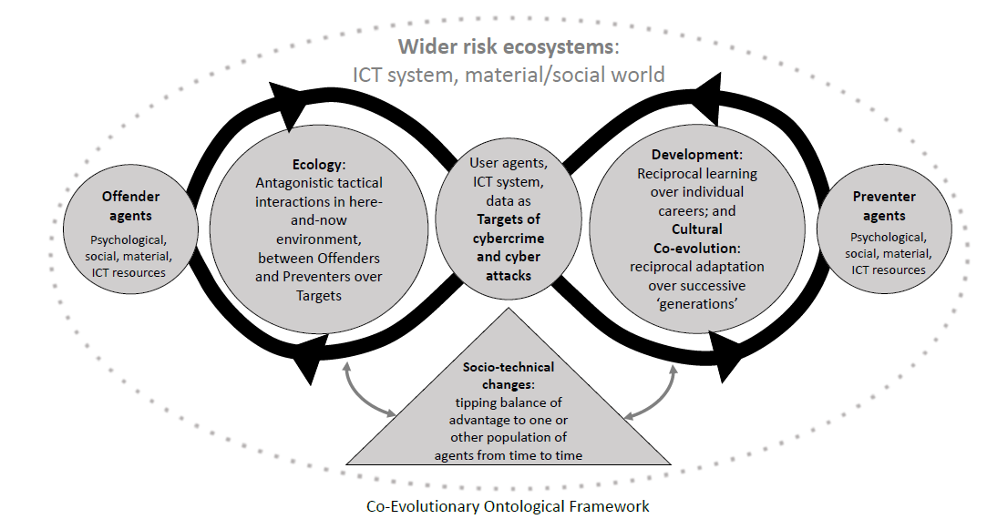
A summary graphic from Project ACCEPT

Slide 39
Conclusions
The 3 timeframes derived from biology offer distinctive ways of looking at crime, its causes and the interventions we can develop to prevent, mitigate or stop it
Some of these build on conventional criminology/crime science, others are novel
Some issues encountered are quite challenging, need further thinking through
How far can we simplify our model of the ecosystem before it starts significantly losing the ability to guide understanding, decisions, planning and action?
Alternatively, how far do we have to better articulate, broaden and integrate our existing crime science frameworks and render them dynamic?
Project ACCEPT is endeavouring to take this process forward with development of an ontology of cybercrime, including human factors
Feedback very welcome! In the meantime, some guidance…

Slide 40
Conclusions – for a Given Crime/Security Problem…
Which timeframe is appropriate for understanding, tackling the problem – eco, devo, evo?
Does a given crime reduction strategy need to address more than one?
What are the units, populations and societal levels of interest?
What are the most appropriate ways to view generations, particularly in the case of actions and things?
How do all the agents and things fit together in a crime ecosystem? (And how does that fit more generally within broader societal systems?)
How does perturbing one element of the system (e.g. offenders) affect all the other adaptive elements? Might there be counterintuitive outcomes, or even backfires?
What factors favour criminals variously at eco, devo or evo levels? Or favour security? How can we boost the latter and bust the former?

